Slide 1

Frontend Development
Besant Technologies
Dhanabalan.cs

Slide 2
WWW
The World Wide Web -- also known as the web, WWW or W3 -- refers to all the public websites or pages that users can access on their local computers and other devices through the internet.
These pages and documents are interconnected by means of hyperlinks that users click on for information.
This information can be in different formats, including text, images, audio and video.
URL: https://www.google.com/search?q=angular
So, this URL is redirecting your web browser to the Google search page with a query parameter that specifies the term "angular" to be searched for.
http/https : HTTP/HTTPS is the standard protocol used for transferring data between a web browser (client) and a web server.
WWW : It is often denotes the World Wide Web.
google.com : Domain. It identifies the location of the web server that hosts the site.
/search : The path indicates the specific location or resource on the web server. In this case, it points to the "search" page or resource on the Google website
?q=angular : Query parameters are used to send data to the web server as key-value pairs. In this example, "q" is the key, and "angular" is the corresponding value. This indicates a search for the term "angular" on the Google search page.

Slide 3
EXERCISE
Understand about website
What is web pages
How each webpage interlinked
What are the types of content can be used in a webpage
What is W3C and its role?

Slide 4
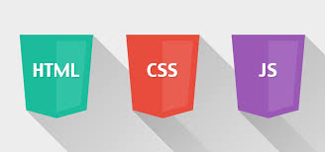

Frontend Development :
Front-end development, often referred to as client-side development
It is the process of designing and creating the user interface and user experience (UI/UX) of a website or web application that users
interact with directly in their web browsers
It involves crafting the visual elements, layout, and functionality that make a website or web app both visually appealing and interactive.
A Front-End Developer is someone who creates websites and web applications.
The difference between Front-End and Back-End is that Front-End refers to how a web page looks, while back-end refers to how it works.
You can think of Front-End as client-side and Back-End as server-side.

Slide 5
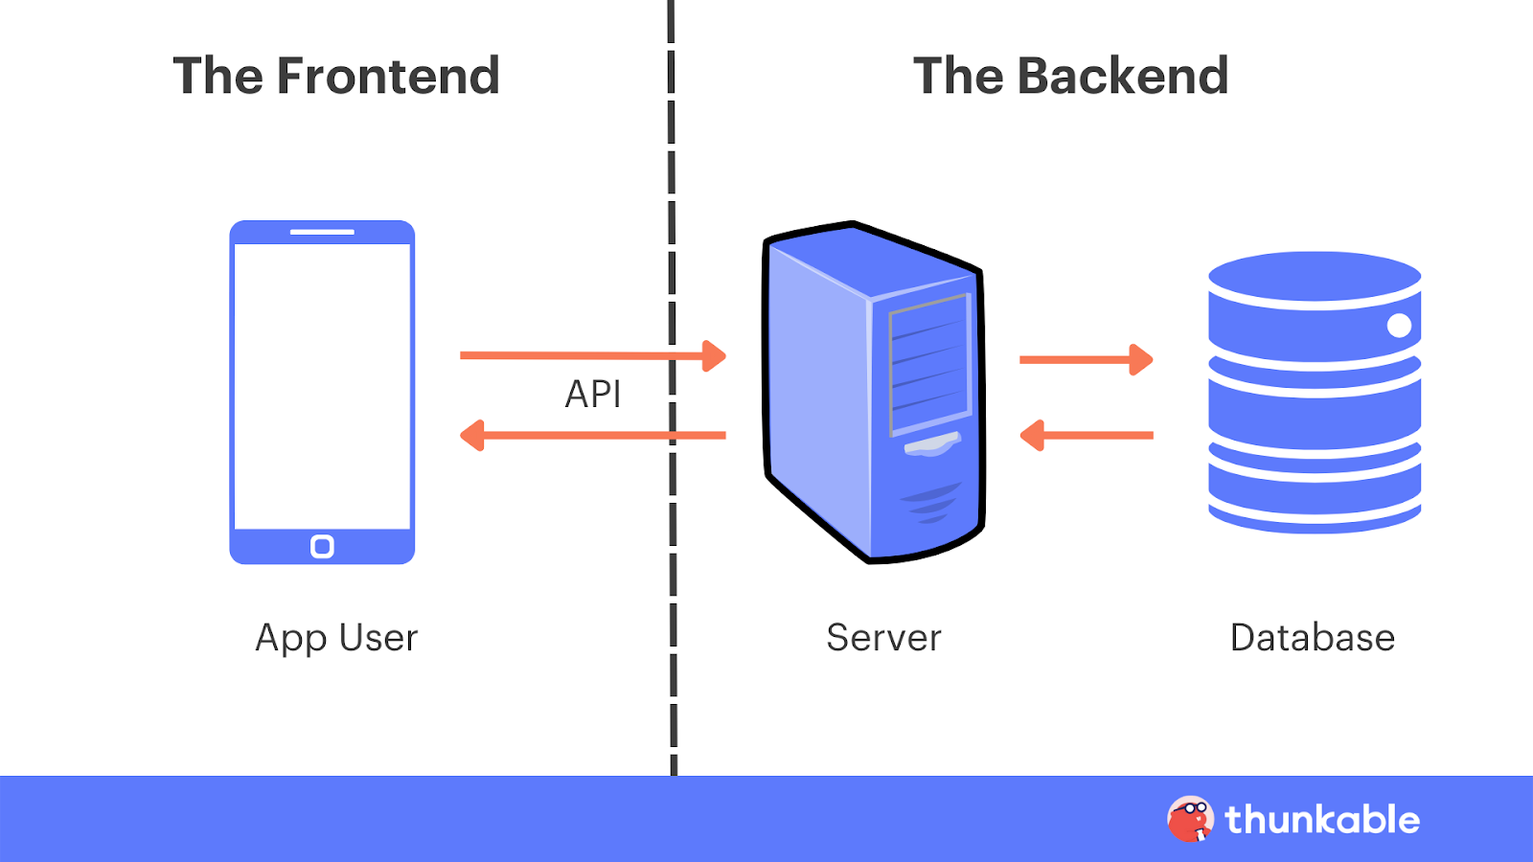
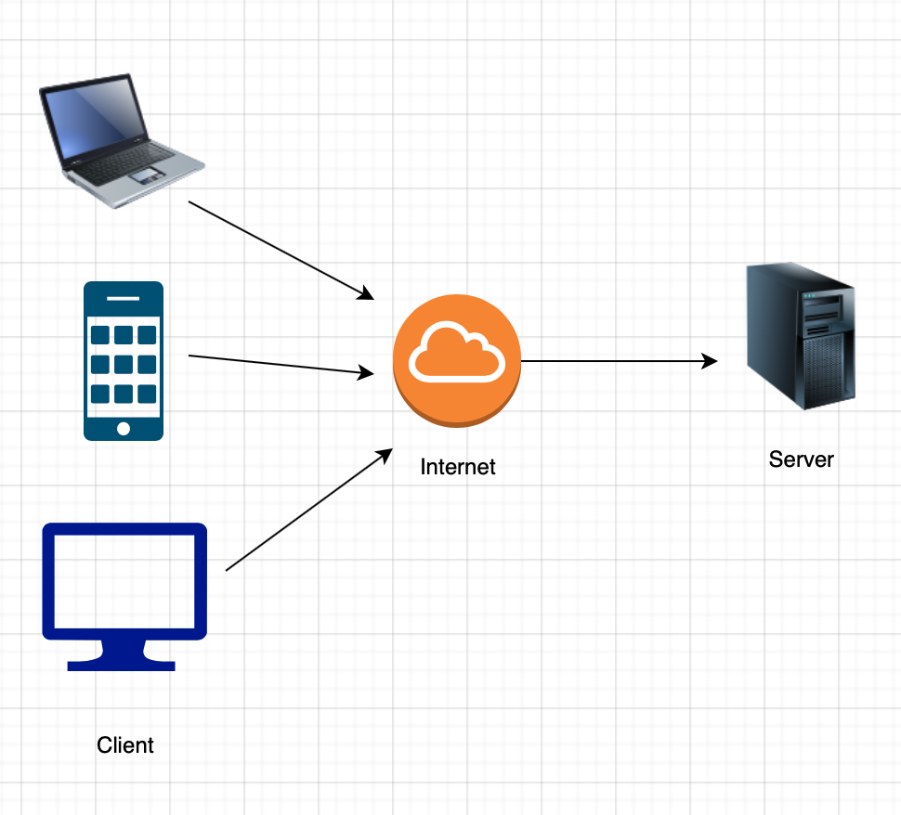
Frontend :
Backend:
Definition: Front-end development, also known as client-side development, involves creating the user interface (UI) and the user experience (UX) of a website or web application that users interact with directly in their web browsers.
Responsibilities:
Design and create web pages, including layout, content, and visual elements.
Use HTML for structuring content, CSS for styling, and JavaScript for interactivity.
Ensure the website is responsive and works well on various devices and screen sizes.
Focus on user-friendly design and accessibility.
Implement animations, transitions, and other visual effects.
Skills:
Proficiency in HTML, CSS, and JavaScript.
Knowledge of front-end libraries and frameworks (e.g., React, Angular, Vue.js).
Understanding of responsive web design principles.
UI/UX design skills are a plus.
DATA FLOW
Definition: Back-end development, also known as server-side development, involves creating the server, databases, and server-side logic that enable a web application to function.
It handles data processing, user authentication, and more.
Responsibilities:
Develop server-side applications and APIs to handle client requests.
Implement business logic and data processing.
Create and manage databases, including data storage and retrieval.
Handle user authentication and authorization.tion, and more
Skills:
Proficiency in server-side programming languages (e.g., Node.js, Python, Ruby, Java, PHP, C#).
Knowledge of back-end frameworks (e.g., Express.js, Django, Ruby on Rails).
Database management skills (SQL or NoSQL databases like MongoDB).
API design and development.

Slide 6
Frontend vs Backend Languages :
Tech Stacks :
Frontend Technologies | Backend Technologies | Database
HTML CSS JavaScript TypeScript Smarty | PHP JAVA NODE C# Python | MySql Sqlite Oracle MongoDb
LAMP Stack : (Linux, Apache, MySQL, PHP)
MEAN Stack : (MongoDB, Express.js, Angular, Node.js)
MERN Stack : (MongoDB, Express.js, React, Node.js)
Full Stack : Developers who have proficiency in both front-end and back-end development using a variety of technology stacks. They are adaptable and can work with different combinations of front-end and back-end technologies based on project requirements.

Slide 7

HTML
What is HTML?
HTML, short for Hyper Text Markup Language
HTML is a standard markup language for web page creation.
It defines the meaning and structure of web content
Other technologies besides HTML are generally used to describe a web page's appearance/presentation (CSS) or functionality/behavior (JavaScript).
First published by Tim Berners-Lee in 1989, HTML is now used by 94% of all websites
Hypertext: Think of "hypertext" like a web of interconnected information. It's a way to organize and link different pieces of information together, like web pages connected by clickable links.
Markup: "Markup" means adding special codes (tags) to text to give it structure and meaning. These codes tell web browsers how to display the text. It's like giving instructions to a web browser on how to format content.
Language: "Language" here refers to a set of rules and symbols used for communication. In this case, HTML is a language that web browsers understand to display web pages correctly.

Slide 8
Is HTML a programming language ??
HTML is not a programming language in the traditional sense.
HTML is a markup language used to structure and present content on the web.
HTML is essential for web development, it's often paired with programming languages like JavaScript to add functionality and interactivity to web pages.
What is HTML used for ?
HTML is primarily used for creating web pages.
HTML is free to use and ensures your text, images, and other elements are displayed as intended.
With HTML, not only can you add headings, paragraphs, lists, and other elements to your page — you can also embed images, videos, audio files, and other multimedia.
make tables for organizing data
create forms
create emails with HTML
Important:
Even after adding headings, images, and hyperlinks, you’d still have a very basic web page — and that’s by design.
HTML is purely for the content of a page.
It creates a simple base upon which you can add styling with another language called CSS (which stands for Cascading Style Sheets).
With CSS, you can customize your styling and layouts, changing the color, font, and alignment of elements.

Slide 9
Where to use HTML:
HTML is used in various contexts and scenarios in web development
Websites:HTML forms the backbone of websites. It's used to create the layout, structure, and content of web pages.
Blogs: HTML is used to structure blog posts, format text, embed media, and create links within blog content.
E-commerce: HTML is used to create product listings, shopping cart interfaces, and checkout processes on e-commerce websites.
Web Forms: HTML provides form elements for collecting user data, such as registration forms, login forms, and feedback forms.

Slide 10
HTML VERSIONS
1991- Tim Berners-Lee invents HTML 1.0.
1993- HTML 1.0 is released. Not many developers are creating websites at this time.
1995- HTML 2.0 is published.
1997- HTML 3.2 was invented.
1999- The widely-used HTML 4.01 comes out. ...
2014- HTML 5.0 is released and used worldwide.
PREREQUISITES
EDITOR: Notepad / Notepad++ / Visual studio code Eclipse
BROWSER: Chrome/ IE /Microsoft Edge / Safari and other browsers..
REFERENCE WEBSITES
https://overapi.com/html
https://developer.mozilla.org/en-US/docs/Web/HTML
https://html.spec.whatwg.org/multipage/ - OFFICIAL HTML DOC
HTML VERSIONS Detailed in NEXT PAGE

Slide 11
HTML 1.0
HTML 1.0 or first version of HTML was a version of SGML that had ability to link different document or pages using 'href'.HTML 1.0 had 20 elements or tags, now latest version of HTML, ie HTML5 has a lot more.
HTML 2.0
After HTML 1.0, the second version of HTML was released in 1994. HTML 2.0 was an expansion of HTML 1.0.Internet Engineering Task Force (IETF) was behind it's creation.
HTML 3.2
HTML 3.2 was released In 1997. HTML 3.2 had many new features like tables, superscript, subscript etc.Two most important features introduced in HTML 3.2 were tables and text flow around images.Tables were widely used and programmers still use them but it is not recommended anymore. In HTML5 div tags and other semantic elements are used more frequently instead of table element.
HTML 4.01
HTML 4.01 was released In 1999. HTML 4.01 introduced features like scripting, style sheets, better tables, better forms frames and embedding objects.HTML 4.01 was a revised version of HTML 4.0, it also included features for the disabled people to enhance their interactivity with the Global world through Internet.
XHTML
In 2000 XHTML was released. XHTML stands for Extensible Hyper Text Markup Language. XHTML has strict set of rules and it is basically an XML application of HTML.
HTML5
So all of this added up and then after so many year HTML5 was released in 2014. HTML5 is the best version of HTML up till now. HTML5 improved user interactivity so much and also lessened the burden of devices.
HTML5 fully supports all kind of media application that are there. HTML5 supports both audio and video media content. HTML5 also provides full support for JavaScript to run in the background.

Slide 12
Create My First HTML FILE
Step 1: Choose a Text Editor
You'll need a text editor to write your HTML code. You can use simple text editors like Notepad (Windows) or TextEdit (Mac), or more specialized code editors like Visual Studio Code, Sublime Text, or Atom.
Step 2: Create a New Folder (Optional)
You can organize your HTML files in a dedicated folder. To create a new folder:
Windows: Right-click in the location where you want to create the folder, select "New," and then choose "Folder." Give it a name, like "MyWebsite."
Step 3: Create the HTML File
Inside your chosen folder, follow these steps to create your HTML file:
Windows:
Open your text editor (e.g., Notepad).
Click "File" in the menu and select "New" to create a new document.
Write your HTML code
Click "File" and select "Save As."
Give file name as "index.html" (or any name you prefer). And Click "Save.

Slide 13
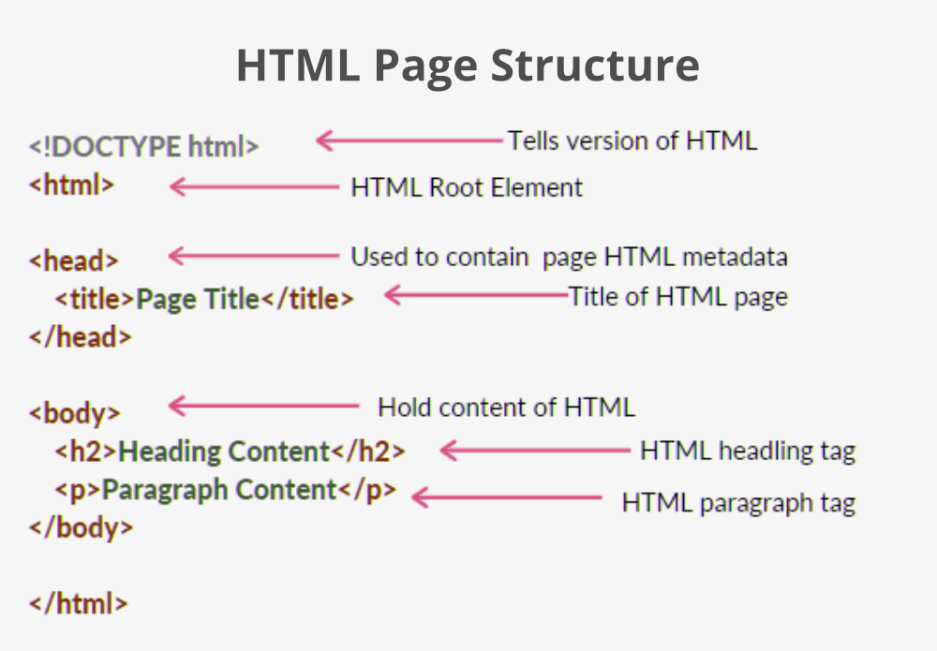
Step 4: View Your HTML File
Now that you've created your HTML file, you can view it in a web browser:
Navigate to your folder (e.g., "MyWebsite").
Find the "index.html" file you created.
Double-click the "index.html" file to open it in your default web browser.
You should see your "Hello, World!" message displayed in the browser.
Syntax
The <!DOCTYPE html> declaration defines that this document is an HTML5 document
The <html> element is the root element of an HTML page
The <head> element contains meta information about the HTML page
The <title> element specifies a title for the HTML page (which is shown in the browser's title bar or in the page's tab)
The <body> element defines the document's body, and is a container for all the visible contents, such as headings, paragraphs, images, hyperlinks, tables, lists, etc.
The <h1> element defines a large heading
The <p> element defines a paragraph

Slide 14
<!DOCTYPE html>
All HTML documents must start with a <!DOCTYPE> declaration.
The declaration is not an HTML tag.
<!DOCTYPE> tag is used to inform the browser about the version of HTML used in the document. It is called as the document type declaration (DTD).
HTML5: <!DOCTYPE html>
HTML 4 : <!DOCTYPE HTML PUBLIC "-//W3C//DTD HTML 4.01 Transitional//EN" "http://www.w3.org/TR/html4/loose.dtd">
XHTML: <!DOCTYPE html PUBLIC "-//W3C//DTD XHTML 1.1//EN" "http://www.w3.org/TR/xhtml11/DTD/xhtml11.dtd">
Valid HTML Elements in Different DOCTYPES:
IMPORTANT:
In summary, while it may not be technically mandatory to include a doctype declaration in your HTML documents,
it is highly recommended to do so. It's a fundamental part of document structure and helps ensure compatibility, consistency, and proper rendering across different platforms and browsers.
Tag | HTML5 | HTML4 | XHTML
<font> | NO | YES | NO
<picture> | YES | NO | NO
<strike> | NO | YES | NO
<video> | YES | NO | NO

Slide 15
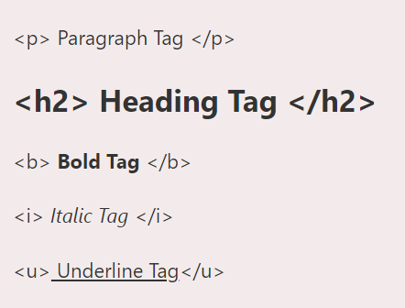
Building Blocks of HTML
Tags Example:
Tags
Attributes
Elements
Tags:
Tag tells the browser how to present the content inside it
Every tag performs a different task,and for every different tasks there are different HTML tags available
Example:
<img /> - Display Image
<b> Welcome to HTML5 </b> - Make text as bold
Tag starts with a less-than angle bracket (<) and ends with a greater-than angle bracket (>) with the tag name in-between. Example <p>, <div>, <h1>, etc.
Generally, there are opening and closing tag for each tag. A tag is close by a less-than angle bracket (<), forward-slash (/), tag name and greater-than angle bracket (>). i.e (</tag>)

Slide 16
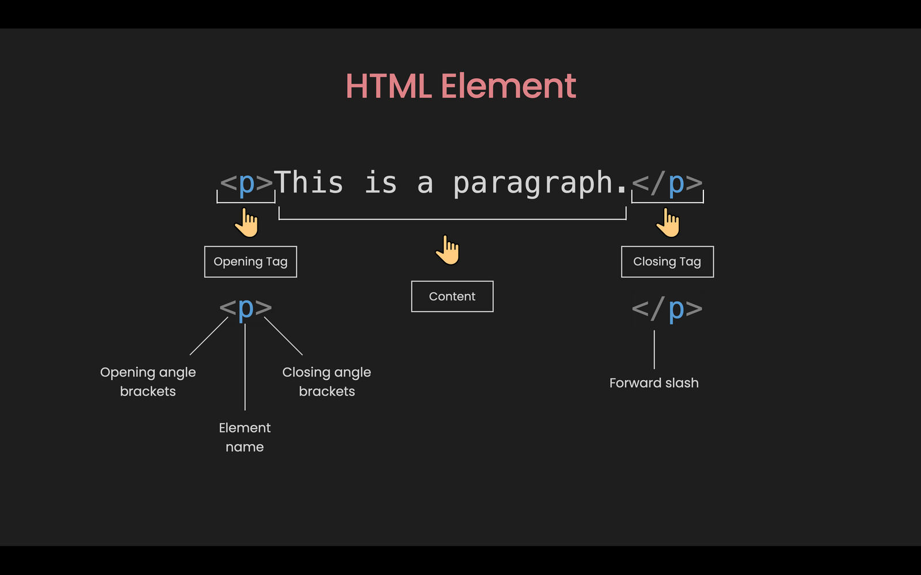
ELEMENTS:
Technically, an element is a collection of start tag, attributes, end tag, content between them.
Elements are responsible for creating web pages and define content in that webpage

Slide 17
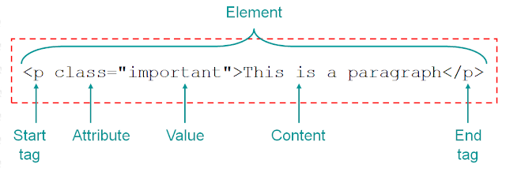
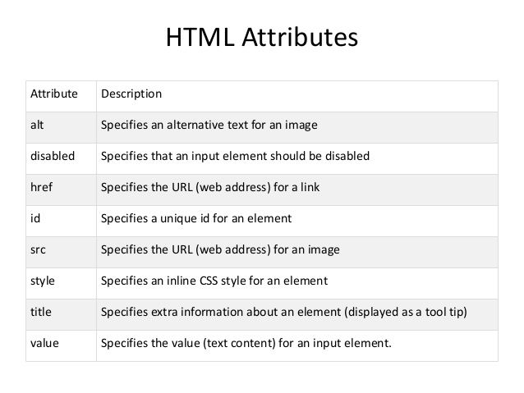
ATTRIBUTES:
Attributes attach extra information to the HTML elements in the form of key-value pair.
This extra information can be adding the title to the element, adding class or id, adding inline style, etc.
The attributes are used to find HTML elements to style it using CSS selectors and is also used by JavaScript to select HTML elements by ID or other attribute or then perform some task over it.
Attributes have two parts: the name and the value. value part should be written in the quote; either in single quote ('') or in the double quote (""). Example title="this is my website"
Attribute is written only in opening tag shown as follows:
<b name="sample"> My First HTML Markup tag</b>

Slide 18
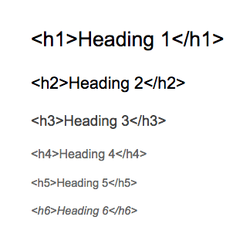
Headings:
Heading tags define a page’s main heading (<h1>) as well as the sub-headings (<h2>-<h6>) of various content sections.
Headings help us to get an idea on the content on the web page.
PRIORITY:
Syntax:
<h1>:
Priority: Highest
Usage: There should be only one <h1> tag per page, and it should represent the main heading or topic of the page. It sets the primary focus and topic for the content.
<h2>:
Priority: High
Usage: <h2> tags are used for subheadings that are directly related to the <h1> tag. They provide a logical subdivision of content under the main topic.
<h3> to <h6>:
Priority: Decreasing from <h3> to <h6>
Usage: These tags are used for further subdividing content within each level of headings. For example, you might use <h3> for subsections within an <h2> section, and so on. The importance of content decreases as you go from <h3> to <h6>.

Slide 19
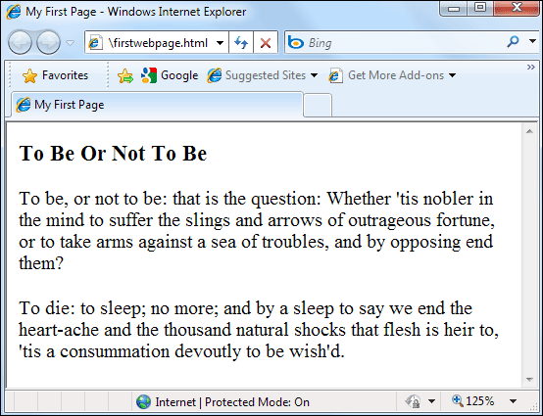
Paragraphs:
Paragraphs sample output:
Purpose: The <p> tag is used to define and structure text content as a paragraph on a web page.
Block-Level Element: It is a block-level HTML element, which means it starts on a new line and creates space both above and below the content it encloses.
Nested Elements: You can include other inline and block-level HTML elements within a <p> tag to format the content further, but it's generally recommended to use other tags like <strong>, <em>, or <div> for more complex structures.
Syntax:
<p>This is a paragraph of text. It can contain various sentences and spans multiple lines.</p>

Slide 20
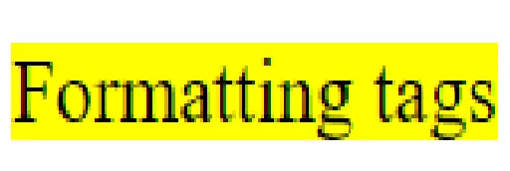
HTML Formatting Tags:
There are various types of formatting tags available to us through which we can write texts in different styles and formats. Different types of formatting tags are:
Bold tag - It does not hold any extra importance other than making text bold. <b>BOLD TEXT</b>
Strong tag- Other than making text bold <strong> tag have symantic importance and it is used to give extra stress and emphasize important words. <strong>STRONG TEXT</strong>
Italic tag - This tag is just used to write text in italic font, it does not hold any special meaning.<i>ITALIC TEXT</i>
Em tag - It is used to emphasize the text. Screen readers put extra verbal stress while reading the text in <em> tags. <em> tag was introduced in HTML5 <em>Emphasized Text</em>
Underline tag - Underline tags are used on important words which require the attention of readers or can be used to underline headings or subheadings <u>Underlined TEXT</u>
Mark tag -
This tag was introduced in HTML5.
Mark tag is used to highlight a word in a sentence.
Mark tag highlights the words by giving them a yellow background. It is supported by all major browsers.
<mark>Formatting tags</mark
Continues

Slide 21

HTML Formatting Tags:
Strike tag
In HTML4 <strike> tag is used to put a horizontal line through words. It can be used in articles to show that some items are deleted or updated from a list or article.
In HTML5 <s> tag is used to write striked text. It is used when a word is no longer relevent or requierd in an article. We should not use <s> tag to represent deleted text <del> tag must be used in that case.
NOTE- <strike> tag is not supported in HTML 5. We can use <s> or <del> instead.
<strike>Text</strike>
<s>Text</s>
<del>Text</del>
Subscript tag- A Subscript is a letter, symbol or a number which is usually in a smaller font size and half a character below the normal line. Subscript tags are used to write chemical formulas like
H<sub>2</sub>O
Superscript tag- A Superscript is a number, letter or symbol which is usually in a smaller font size and half a character above the normal line. Superscript tags are used to write mathematical equations
x<sup>2</sup>+ y<sup>2</sup>
Continues

Slide 22
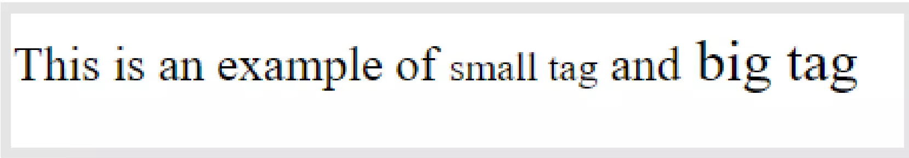
HTML Formatting Tags:
Deleted and Inserted tag
Delete tag is used for text which is no longer required or has to be deleted.
Browsers render deleted text as strike-through text.
While <ins> tag is used to insert updated or new text in the article.
Text enclosed by <ins> tag is renderd as underlined text by browsers.
Delete and insert tags are used to add and remove words.
<del>Text</del>
<ins>Text</ins>
Big and Small Texts
HTML <big> tag makes the font of text one size bigger than the surrounding text i.e from small to medium, medium to big.
HTML <small> tag makes font of text one size smaller than the surrounding text i.e from big to medium, medium to small.
Note- Big tag is not supported in HTML5 while the small tag is.
Big and small tags are used to make the font one size bigger and smaller than the default font size.
Instead of the big tag, we can change the font size of the text by using CSS.
<big>Text</big>
<small>Text</small>
Continues

Slide 23
SELF EXPLORE -TAGS
<kbd>
<code>
<samp>
<var>

Slide 24
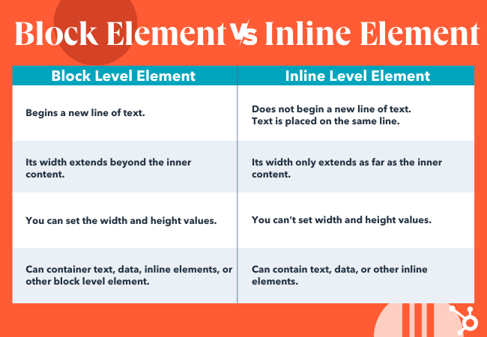
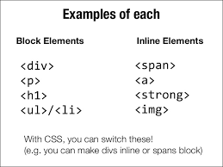
<pre>: it represents preformatted text which is to be presented exactly as written in the HTML file
<pre>SOME TEXT</pre>
<hr />: Horizontal Ruler <hr />
<br />: Create a Line Break <br />
<div> (Block-Level Element):
The <div> element is a block-level container used for grouping and structuring content.
It is often used with CSS for layout purposes, such as creating sections, columns, or containers for various elements.
<div>
<h1>Header</h1>
<b>Bold text</b>
<p>This is some content.</p> </div>
<span> (Inline Element):
The <span> element is an inline container used to apply styling or manipulate small portions of text or inline elements within a block-level element..
<p>This is a <span style="color: red;">red</span> word.</p>

Slide 25
<a> The Anchor Tag
The <a> tag, also known as the anchor tag and it is used to create hyperlinks on a web page.
Hyperlinks are clickable elements that allow users to navigate to other web pages, resources, or locations
The most important attribute of the <a> element is the href attribute, which indicates the link's destination.
By default, links will appear as follows in all browsers:
An unvisited link is underlined and blue
A visited link is underlined and purple
An active link is underlined and red
We can create Hyperlinks to:
web pages
files
email addresses
locations in the same page - BookMarking
EXAMPLE:
<a href="https://www.amazon.com/">AMAZON</a>
<a href="sample.pdf">DOWNLOAD AS PDF</a>
<a href="mailto:john@gmail.com" title="email">Email</a>
<a target="_self" href="demo.html#bookmark">Navigate to specific part of a page</a>
<a href="javascript:alert('welcome!');">Execute JavaScript</a>

Slide 26
The Anchor Tag Attributes
href: This is the most important attribute of the <a> tag, and it specifies the URL or destination to which the link points. It can be an external URL or a relative URL to an internal page or resource.
<a href="https://www.example.com">Visit Example.com</a>
target: This attribute determines how the linked content will be displayed. Common values include:
_self (default): Opens the linked document in the same window or tab.
_blank: Opens the linked document in a new browser window or tab.
_parent: Opens the linked document in the parent frame or window.
_top: Opens the linked document in the top-level frame or window.
<a href="https://www.example.com" target="_blank">Visit Example.com in a new tab</a>
title: The title attribute provides additional information about the link, often displayed as a tooltip when the user hovers over the link. It's useful for providing context or describing the link's purpose.
<a href="https://www.example.com" title="Visit Example.com">Example.com</a>
id and class: You can apply id and class attributes to the <a> tag to target it for styling with CSS or for JavaScript interaction.
<a href="#" id="my-link" class="important-link">Click me</a>
download: When used, this attribute suggests to the browser that the linked resource should be downloaded as a file instead of navigating to it. The attribute's value is the desired filename for the downloaded file.
<a href="document.pdf" download="my-document.pdf">Download PDF</a>

Slide 27
HTML COMMENTS
In HTML, you can use comments to add notes or explanations to your code that are not displayed to website visitors.
Comments are helpful for documenting your code, providing context, or temporarily disabling specific sections of code during development.
Single Line Comments
<!-- This is a single-line comment -->
Multi Line Comments
<!-- This is a
multi-line
comment -->

Slide 28

<img> Tag
The <img> HTML element embeds an image into the document
< img src=”flower.png” alt=”flower” title=”Rose” style=”width:200px; height:200px” />
Attributes:
The src attribute is required, and contains the path to the image you want to embed.
The alt attribute holds a text description of the image, which isn't mandatory but is incredibly useful for accessibility — screen readers read this description out to their users so they know what the image means. Alt text is also displayed on the page if the image can't be loaded for some reason: for example, network errors.
Supported image formats:
gif
jpeg
png
svg
webp
EXAMPLE:
<img src="https://angular.io/assets/images/logos/angular/shield-large.svg" alt="Angular" width="100px" height="200px"> (absolute URL)
<img src="/media/cc0-images/grapefruit-slice-332-332.jpg" alt="Grapefruit slice atop a pile of other slices" title="Fruit" /> (Relative URL)

Slide 29
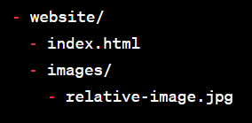
ABSOLUTE PATH
An absolute path specifies the full URL or file path to the image or assets, starting from the root directory of the website or the entire file system.
Example <img src="https://angular.io/assets/images/logos/angular/shield-large.svg" alt="Angular" width="100px" height="200px"><
In this example, the image source (src) is an absolute URL, which means the image is hosted on a remote server and can be accessed directly via the internet.
RELATIVE PATH
A relative path specifies the path to the image relative to the current web page or the HTML file's location.
Relative paths are often used for images within the same website directory structure.
Suppose you have the following directory structure:
Example <img src="images/relative-image.jpg" />
In this example, the image source (src) uses a relative path, so the browser looks for the image in the "images" directory located in the same directory as the HTML file.
When using relative paths, it's crucial to understand the directory structure of your website and specify the correct path to the image relative to the HTML file's location.
This allows you to keep your image references organized and maintainable as you build your website.

Slide 30
QUESTION- TIME
1 . Which should use absolute Path or relative path ?
2. How to make clickable / i want to redirect to http://www.google.com, when i click an image. How?
3. What is Broken Links?
4. I want to download a zip directory, while clicking a LINK.
5. How do you create a clickable phone number link using the <a> tag for mobile devices?

Slide 31
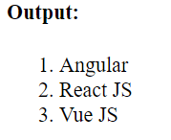
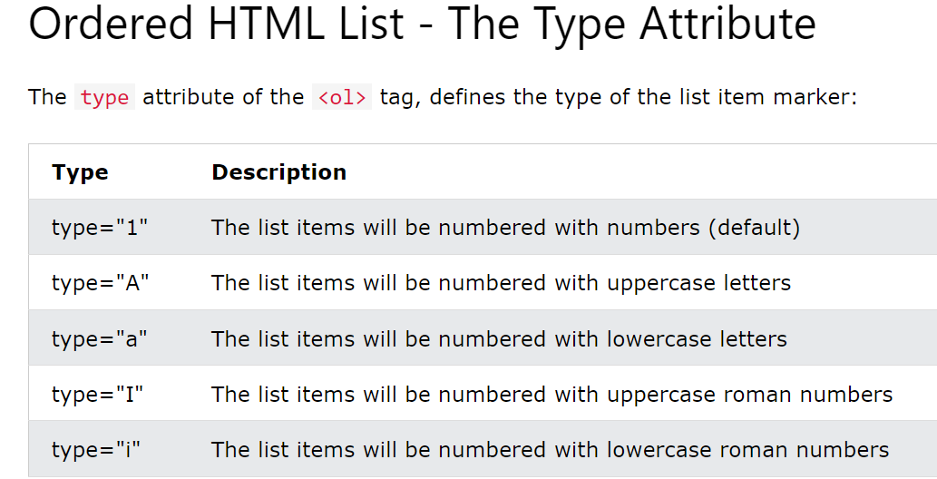
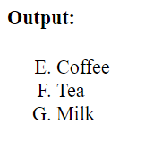
LISTS in HTML
You can create lists to organize and display information in an ordered or unordered manner.
There are three main types of lists in HTML
Ordered Lists (<ol>):
Ordered lists are used when you want to display a list of items in a specific sequence or order, typically with numbers or letters indicating the order.
Each list item is preceded by a number or letter. Here's an example of an ordered list:
<ol type="A" start="5">
<li>Coffee</li>
<li>Tea</li>
<li>Milk</li>
</ol>
<ol>
<li>Angular</li>
<li>React JS</li>
<li>Vue JS</li>
</ol>
Continues

Slide 32
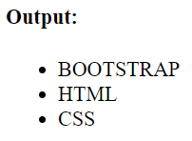
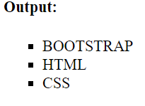
Unordered Lists (<ul>):
Unordered lists are used for lists of items that do not have a specific order.
Typically, they are displayed with bullet points.
<ul type=”square”>
<li>BOOTSTRAP</li>
<li>HTML</li>
<li>CSS</li>
</ul>
<ul>
<li>BOOTSTRAP</li>
<li>HTML</li>
<li>CSS</li>
</ul>
type="disc" (default): This is the default value, and it displays list item markers as filled circles.
type="circle": It displays list item markers as hollow circles.
type="square": It displays list item markers as squares.
Continues

Slide 33
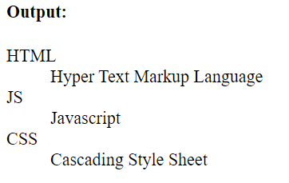
DEFINITION Lists (<dl>):
Definition lists are used to create lists of terms and their corresponding definitions.
A <dl> element contains a series of <dt> (definition term) elements for terms and <dd> (definition description) elements for their corresponding definitions
<dl>
<dt>HTML</dt>
<dd>Hyper Text Markup Language</dd>
<dt>JS</dt>
<dd>Javascript</dd>
<dt>CSS</dt>
<dd>Cascading Style Sheet</dd>
</dl>

Slide 34
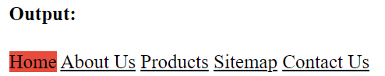
HTML CLASS ATTRIBUTE:
The HTML class attribute is used to specify a class for an HTML element.
Multiple HTML elements can share the same class.
The class attribute is often used to point to a class name in a style sheet.
It can also be used by a JavaScript to access and manipulate elements with the specific class name.
Multiple elements can have the same class
An element can belong to multiple classes by separating them with spaces.
To create a class; write a period (.) character, followed by a class name. Then, define the CSS properties within curly braces {}
<style>
.menu-item {
color: #000;
}
.active {
background-color: #e74c3c;
text-decoration: none;
}
</style>
<a href="#" class="menu-item active">Home</a>
<a href="#" class="menu-item ">About Us</a>
<a href="#" class="menu-item ">Products</a>
<a href="#" class="menu-item ">Sitemap</a>
<a href="#" class="menu-item ">Contact Us</a>

Slide 35
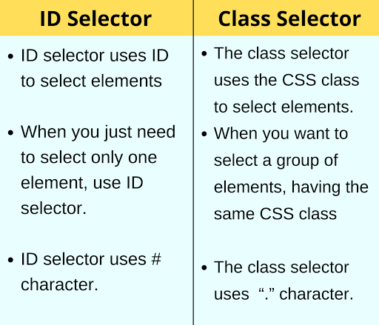
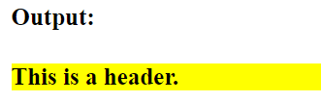
HTML ID ATTRIBUTE:
The id attribute is used to uniquely identify a specific HTML element on a page.
Unlike classes, each ID should be unique within a document.
This uniqueness allows you to precisely target and style or manipulate a single element
The syntax for id is: write a hash character (#), followed by an id name. Then, define the CSS properties within curly braces {}.
<style>
#header
{
background-color: yellow;
font-weight: bold;
}
</style>
<div id="header">
This is a header.</div>

Slide 36
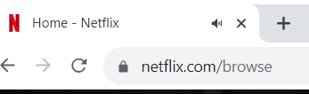
HTML FAVICON:
A favicon is a small image displayed next to the page title in the browser tab.
NOTE: A favicon is a small image, so it should be a simple image with high contrast.
Create Your Favicon Image:
First, create an icon image that you want to use as your favicon. Favicon images are typically square and can be in various formats such as ICO, PNG, or SVG. The most common format is ICO, but modern browsers also support PNG and SVG favicons.
Choose an Appropriate File Format:
Decide which format you want to use for your favicon. If you choose ICO, you'll need to create an ICO file. If you prefer PNG or SVG, make sure your favicon is saved in one of those formats.
Name Your Favicon File:
Save your favicon image with an appropriate name. The recommended name is "favicon.ico" for ICO files, but if you're using PNG or SVG, you can still name it "favicon.png" or "favicon.svg" for clarity.
Upload Your Favicon Image:
Upload your favicon image to your website's server or a web hosting service. Make sure it's accessible via a URL
(e.g., "https://example.com/favicon.ico").
Add the Favicon to Your HTML Document:
Open the HTML document where you want to add the favicon and include the following code inside the <head>
Section:
Syntax:
<head>
<title>My Page Title</title>
<link rel="icon" type="image/x-icon" href="favicon.ico">
</head>
FAVICON

Slide 37
HTML Practicals#1 : Please read the requirement carefully and implement
Create a webpage using following requirements:
Create a Header Part of the webpage, it should contain your company logo
(use div and img tag and other styles as per your creativity)
Then Create a Navigation section using anchor tag (Home, About, contact, products and some download Link). Hyperlink Should Not be broken.
Add FAVICON to your page
Try to apply Background color for an entire page
Please go to the URL: https://scribemedia.com/book-subtitle/
Create Some headings and subheadings
Under every headings i i need sample paragraph contents
Need Every headings & Subheadings should be underlined
Some Important keyword should be highlighted in paragraph
Formatting tags should be used across this page
Use Some valid images in your website
Add Lists in your webpage
Note: (The following coding practice should follow)
Proper directory Structure and use proper fileName
Include doctype in your file
Add Comments (Author/Createddate/Purpose)
Don’t use inline Styles, except some scenarios
Practice attributes like ID,CLASS
All html tag should be in small letters
Notes:
whats

Slide 38
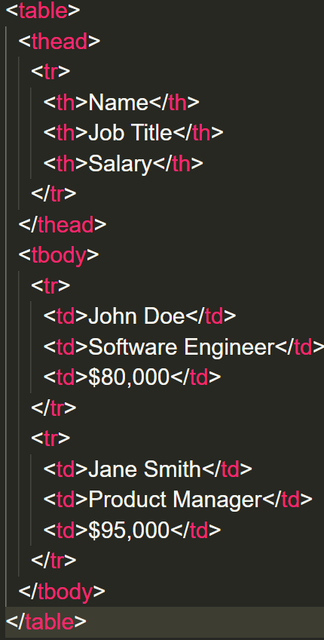
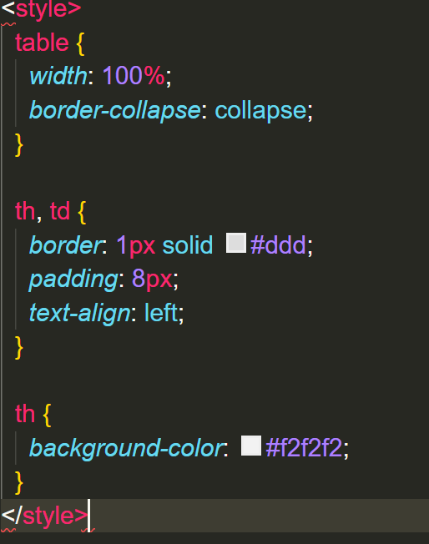
HTML5 TABLES
HTML tables are used to display data in rows and columns on a web page.
They consist of several HTML elements, including the <table>, <tr>, <th>, and <td> elements.

Slide 39
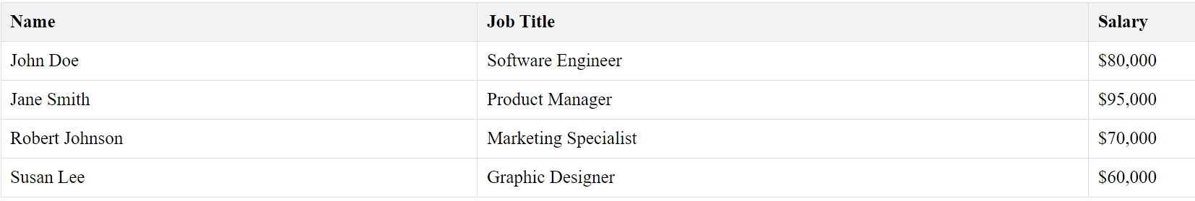
In this example:
The <table> element is used to create the table.
The <thead> element contains a row of table headers (<th>) to define column headings.
The <tbody> element contains the actual data rows.
Each row of the table is defined using the <tr> (table row) element. Within each row, you can use <th> (table header) elements for headers in the table's header row and <td> (table data) elements for data cells in the data rows.
Here's a breakdown of what the CSS styles in the <style> section do:
width: 100%;: Makes the table span the entire width of its container.
border-collapse: collapse;: Collapses the borders of adjacent table cells into a single border, creating a cleaner appearance.
th, td: Styles both header and data cells with a border, padding, and left-aligned text.
th: Styles header cells with a background color to distinguish them from data cells.

Slide 40
Add TABLE BORDER
COLLAPSED TABLE BORDER
To add a border, use the CSS border property on table, th, and td elements.
table, th, td {
border: 1px solid black;
}
To avoid having double borders, set the CSS border-collapse property to collapse.
table, th, td {
border: 1px solid black;
border-collapse: collapse;
}
TABLE CELL PADDING
TABLE CELL Spacing
Cell padding is the space between the cell edges and the cell content.
By default the padding is set to 0.
To add padding on table cells, use the CSS padding property:
th, td {
padding: 15px;
}
Cell spacing is the space between each cell.
By default the space is set to 2 pixels.
To change the space between table cells, use the CSS border-spacing property on the table element
table {
border-spacing: 30px;
}
TABLE STYLE : ZEBRA STRIPES
Add TABLE CAPTION
If you add a background color on every other table row, you will
get a nice zebra stripes effect. (even / odd rows)
To style every other table row element, use the :nth-child(even) selector like this:
tr:nth-child(even) {
background-color: darkgrey;
}
You can add a caption that serves as a heading for the entire table.
<caption>Students Result</caption>

Slide 41
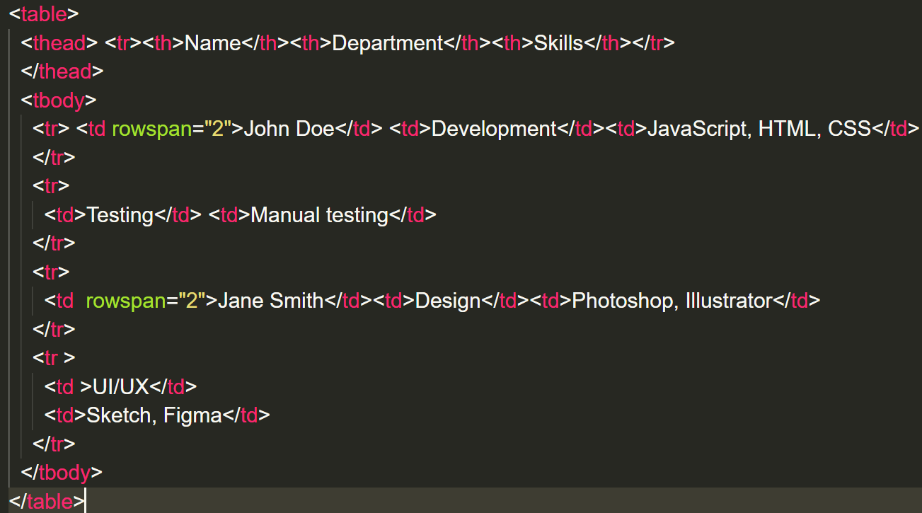
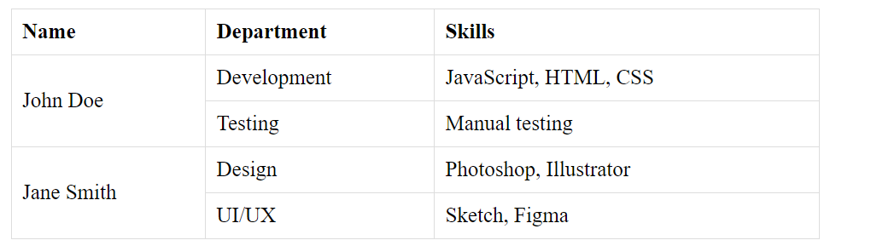
TABLE ROWSPAN
you can use the rowspan attribute to make a cell span multiple rows.
This attribute is applied to a <td> or <th> element and specifies how many rows the cell should span.
This is useful when you want to create a table with rows that have cells that cover multiple rows.

Slide 42
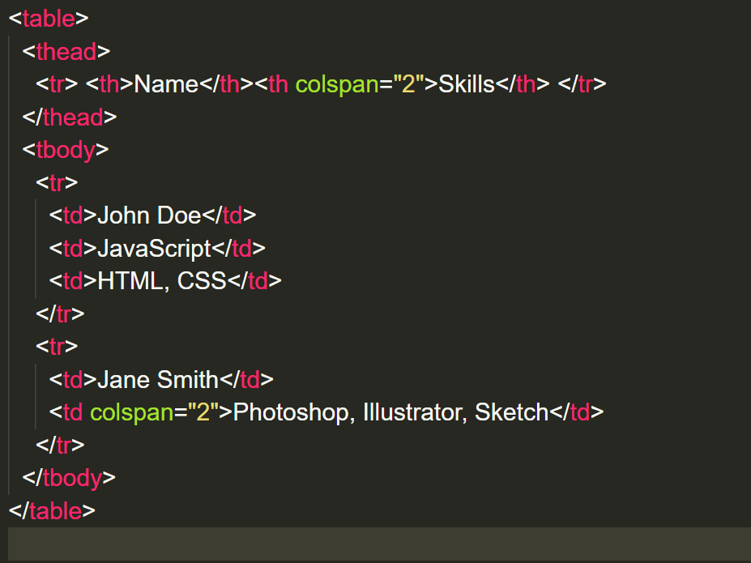
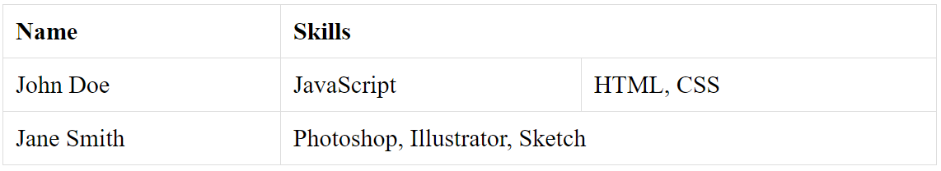
TABLE COLSPAN
In HTML tables, you can use the colspan attribute to make a cell span multiple columns.
This attribute is applied to a <td> or <th> element and specifies how many columns the cell should span.
This is useful when you want to create a table with cells that cover multiple columns

Slide 43
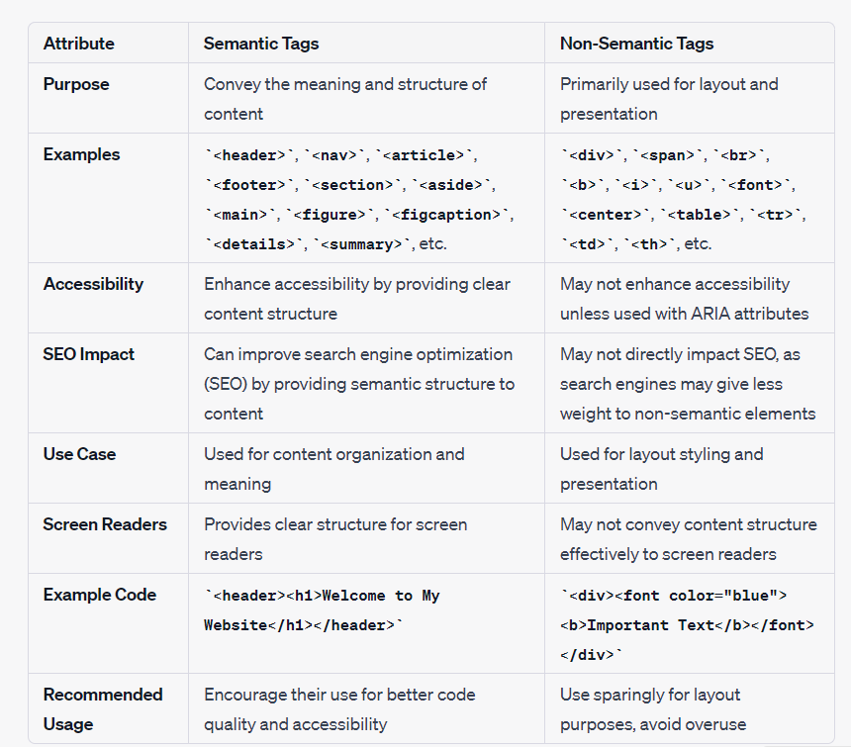

Slide 44
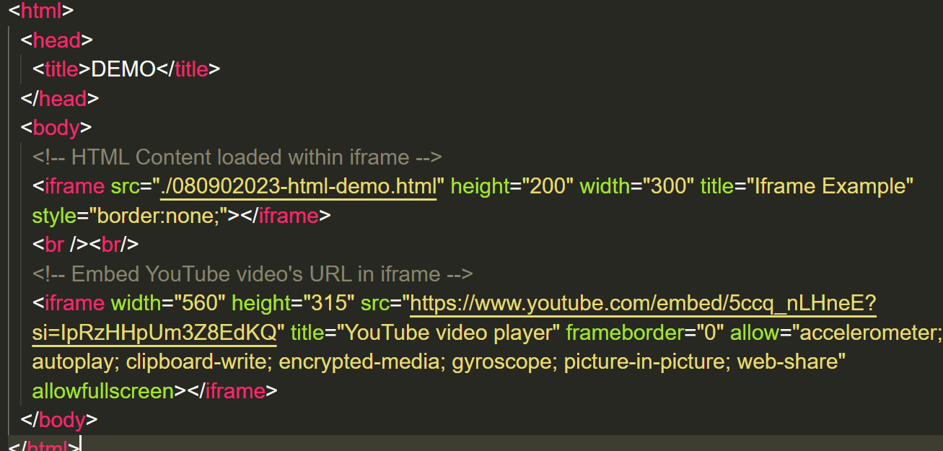
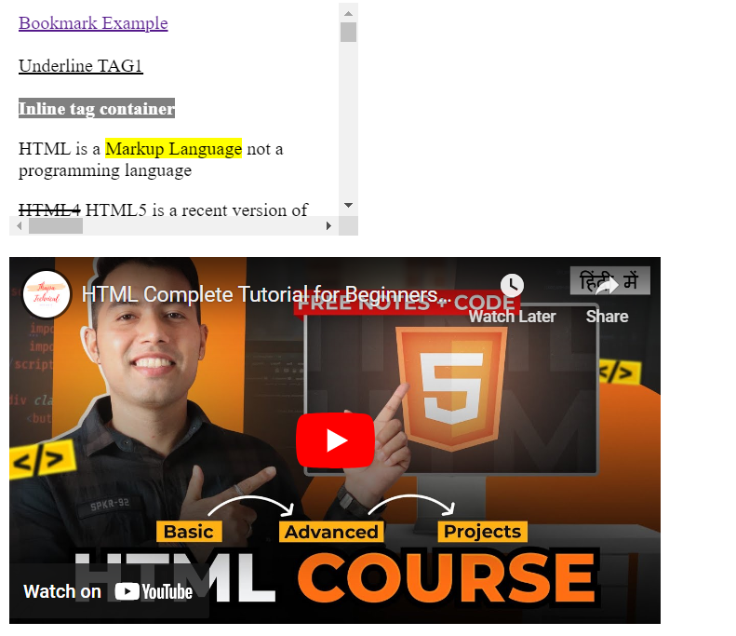
HTML iframe Tag:
The HTML <iframe> tag specifies an inline frame.
It is used to embed another HTML document or web page within the current web page.
It allows you to display content from another source, such as an external website, video, map, or document, directly within your web page.
Here's an example of how to use the <iframe> element:
OUTPUT:

Slide 45
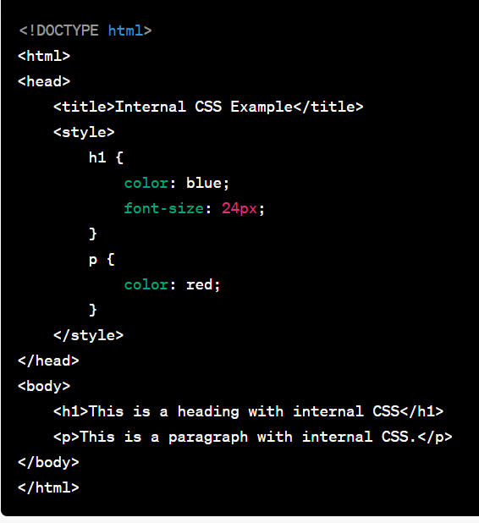
Three Primary ways to apply CSS to HTML DOCUMENTS:
Inline CSS
Internal CSS
External CSS.
Internal CSS:
Internal CSS is defined within the <style> element in the HTML document's <head> section.
It applies to all HTML elements within the same document.
Internal CSS is useful when you want to apply styles to multiple elements within a single HTML document.
Example of Internal CSS:
Inline CSS:
Inline CSS is applied directly to individual HTML elements using the style attribute within the HTML tag.
Inline CSS is useful for making quick, specific style changes to individual elements but is generally not recommended for larger-scale styling.
Example of Inline CSS:
<h1 style="color: blue; font-size: 24px;">
This is a heading with inline CSS
</h1>
<p style="color: red;">
This is a paragraph with inline CSS.
</p>

Slide 46
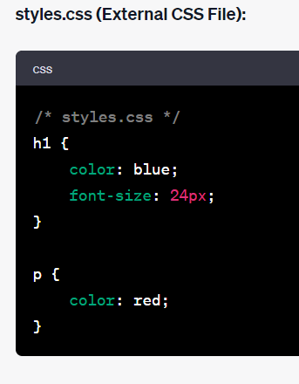
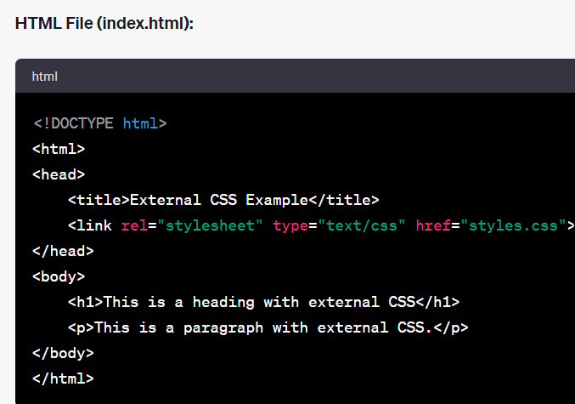
External CSS
External CSS is stored in a separate .css file and linked to the HTML document using the <link> element.
This approach allows you to maintain styles separately from the HTML content and reuse styles across multiple pages.
External CSS is recommended for larger websites with multiple pages and for better organization of styles.
Example of Internal CSS:
In this example, the CSS rules are defined in an external .css file (styles.css), and the HTML document links to this file using the <link> element.
The styles are applied to the HTML elements according to the rules defined in the external CSS file.
Using external CSS is a recommended practice for maintaining scalable and maintainable stylesheets in larger web projects, as it promotes separation of concerns between content and presentation.

Slide 47
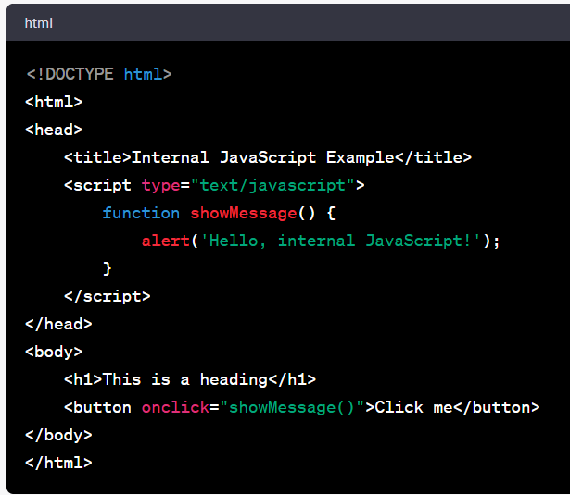
Three Primary ways to apply Javascript to HTML DOCUMENTS:
Inline JS
Internal JS
External JS.
Internal JS:
Internal JavaScript is defined within the <script> element in the HTML document's <head> or <body> section. It applies to all HTML elements within the same document.
Internal JavaScript is useful when you want to include script logic specific to a single HTML document.
Example of Internal CSS:
Inline JS:
Inline JavaScript is placed directly within the HTML document
Inline JavaScript is useful for making quick, specific script implementations directly within HTML elements.
Example of Inline JS:
<button onclick="alert('Hello, inline JavaScript!')">Click me</button>
In this example, the onclick attribute contains inline JavaScript code that triggers an alert when the button is clicked.

Slide 48
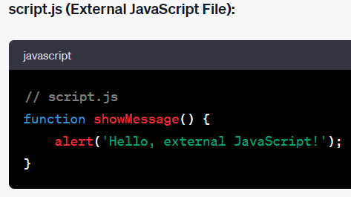
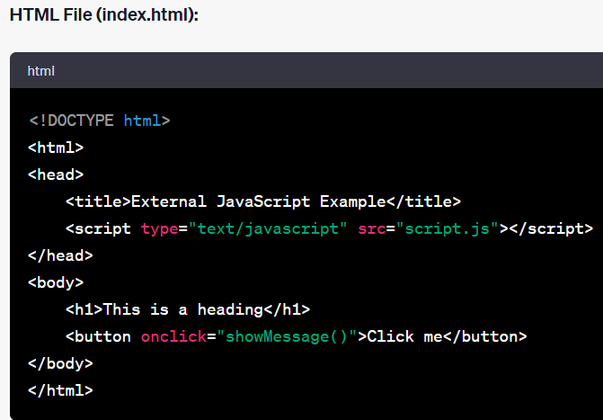
External JS
External JavaScript is stored in a separate .js file and linked to the HTML document using the <script> element with the src attribute.
External JavaScript allows you to maintain your scripts separately from HTML content and reuse them across multiple pages.
Example of Internal CSS:
In this example, the JavaScript function showMessage() is defined in an external .js file (script.js) and linked to the HTML document using the <script> element's src attribute.
The function can be reused across multiple HTML files.
Using external JavaScript is a common practice for maintaining clean and reusable code in larger web projects, similar to using external CSS for styles.

Slide 49
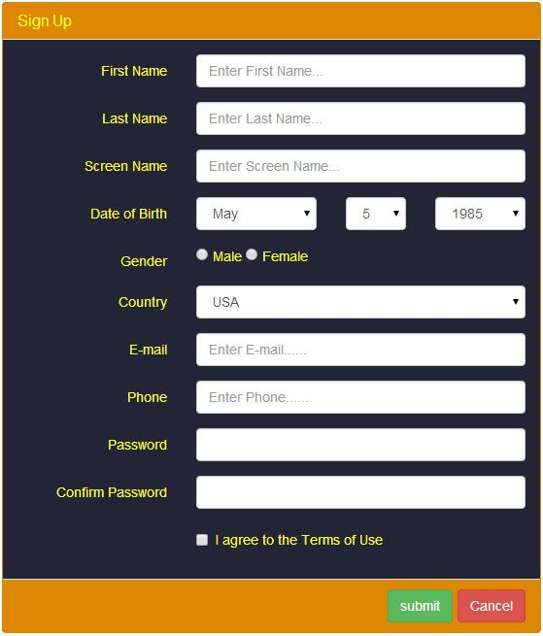
Forms:
What is Forms?
An HTML or a Web form helps collect user input.
An HTML form is a container for various form elements like text fields, checkboxes, radio buttons, buttons, and more.
The collected data can be validated on the client browser using JavaScript.
After validation of form data on the client-side, the user clicks on the Submit button in the form.
After this, data is sent to the server for further processing.
Create Forms Using HTML:
To create an HTML form, we will use the HTML <form> element.
It starts with the <form> tag and ends with the </form> tag.
We can add the input elements within the form tags for taking user input.
Syntax:
<form>
<input type=”email” />
<input type=”password” />
</form>

Slide 50
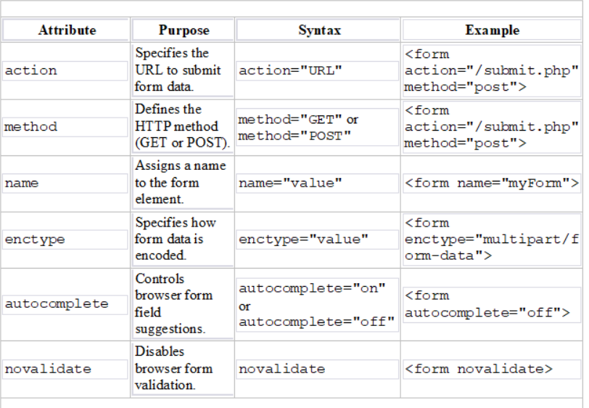
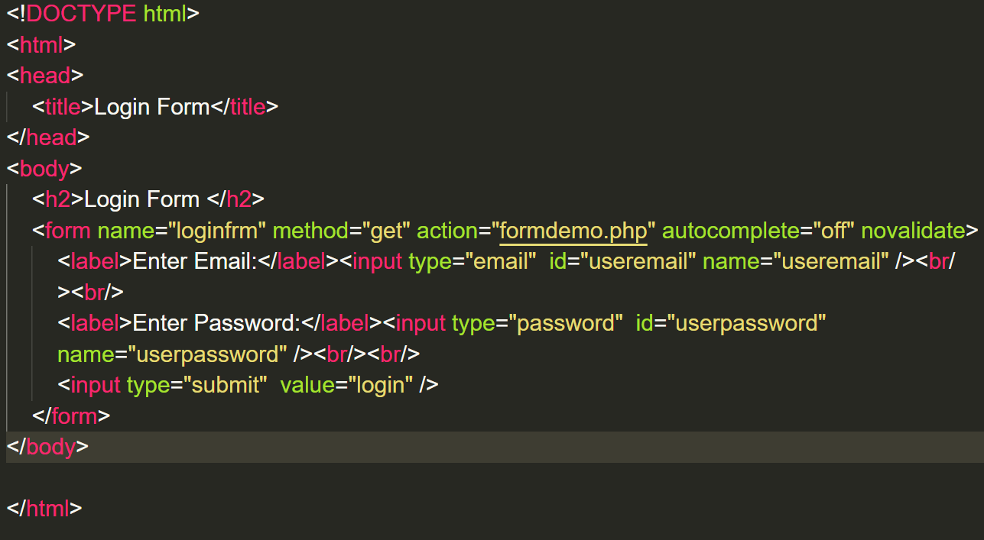
Form Attributes:
HTML forms use various attributes to control their behavior and appearance.
Here are some of the most commonly used form attributes:

Slide 51
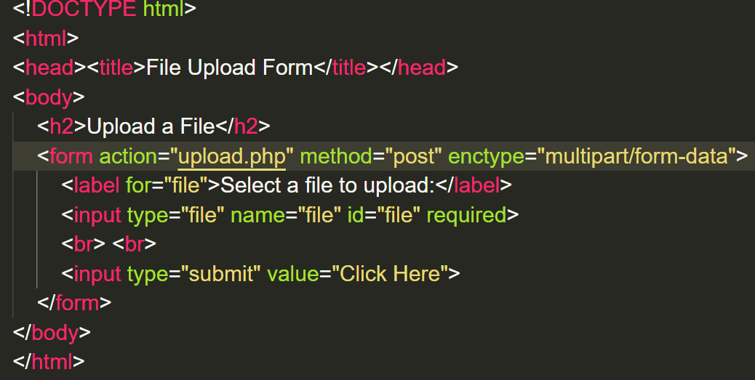
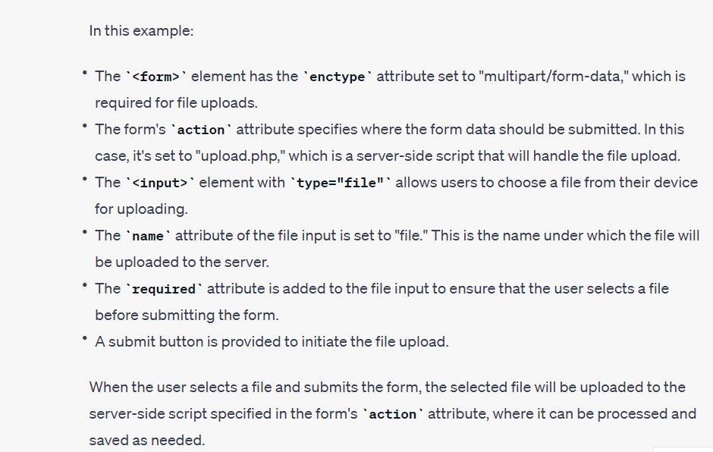
Form Attributes:
<form enctype="multipart/form-data" >
The enctype attribute with the value "multipart/form-data" is commonly used in HTML forms when you want to allow file uploads.

Slide 52
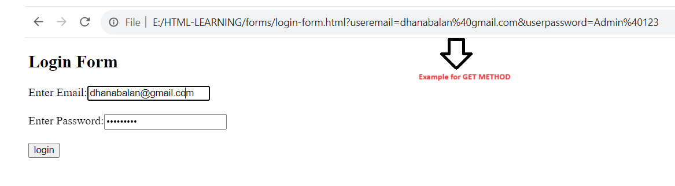
Form Attributes:
GET:
Appends the form data to the URL, in name/value pairs
NEVER use GET to send sensitive data! (the submitted form data is visible in the URL!)
The length of a URL is limited (2048 characters)
Useful for form submissions where a user wants to bookmark the result
GET is good for non-secure data, like query strings in Google

Slide 53
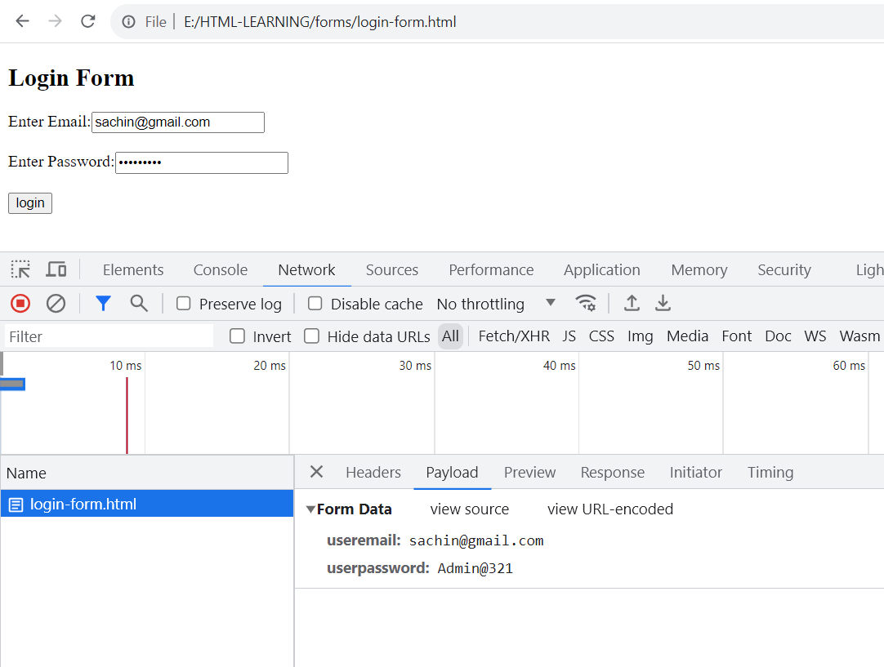
Form Attributes:
POST:
Appends the form data inside the body of the HTTP request (the submitted form data is not shown in the URL)
POST has no size limitations, and can be used to send large amounts of data.
Form submissions with POST cannot be bookmarked
Note: Always use POST if the form data contains sensitive or personal information!

Slide 54
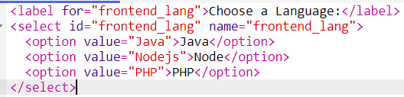
Form Elements : HTML provides various form elements that allow users to input data and interact with web applications. Here's a list of common HTML form elements:
<input>
<label>
<select>
<textarea>
<button>
<fieldset>
<legend>
<datalist>
<output>
<option>
<optgroup>
<label>:
The <label> element defines a label for several form elements.
The <label> element is useful for screen-reader users, because the screen-reader will read out loud the label when the user focus on the input element.
The <label> element also help users who have difficulty clicking on very small regions (such as radio buttons or checkboxes) - because when the user clicks the text within the <label> element, it toggles the radio button/checkbox.
The for attribute of the <label> tag should be equal to the id attribute of the <input> element to bind them together.

Slide 55
<select> :
The <select> element defines a drop-down list:
Visible Values:
Use the size attribute to specify the number of visible values:
Example
<label for="lang">Your Favourite Language:</label>
<select id="lang" name="lang">
<option value="angular">Angular</option>
<option value="react">React JS</option>
<option value="hml">HTML</option>
</select>
Example
<select id="cars" name="cars" size="3">
<option value="volvo">Volvo</option>
<option value="saab">Saab</option>
<option value="fiat">Fiat</option>
<option value="audi">Audi</option>
</select>
The <option> element defines an option that can be selected.
By default, the first item in the drop-down list is selected.
To define a pre-selected option, add the selected attribute to the option:
Allow Multiple Selections:
Use the multiple attribute to allow the user to select more than one value
Example
<select id="cars" name="cars" multiple >
<option value="volvo">Volvo</option>
<option value="saab">Saab</option>
<option value="fiat">Fiat</option>
<option value="audi">Audi</option>
</select>
Example
<option value="fiat" selected>Fiat</option>

Slide 56
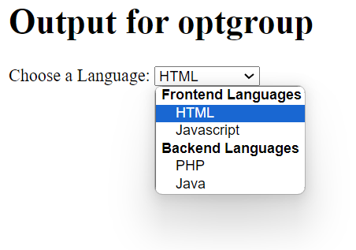
<optgroup> :
The <optgroup> tag is used to group related options in a <select> element (drop-down list).
If you have a long list of options, groups of related options are easier to handle for a user.
Example
<label for="cars">Choose a Language:</label>
<select name="development" id="development">
<optgroup label="Frontend Languages">
<option value="html">HTML</option>
<option value="js">Javascript</option>
</optgroup>
<optgroup label="Backend Languages">
<option value="php">PHP</option>
<option value="java">Java</option>
</optgroup>
</select>

Slide 57
<textarea> :
The <textarea> tag defines a multi-line text input control.
The <textarea> element is often used in a form, to collect user inputs like comments or reviews.
A text area can hold an unlimited number of characters, and the text renders in a fixed-width font (usually Courier).
The size of a text area is specified by the cols and rows attributes (or with CSS).
The name attribute is needed to reference the form data after the form is submitted (if you omit the name attribute, no data from the text area will be submitted)
<textarea id="computer" name="computer" rows="4" cols="50">
A computer is a machine that can be programmed to carry out sequences of arithmetic or logical operations (computation) automatically. Modern digital electronic computers can perform generic sets of operations known as programs. These programs enable computers to perform a wide range of tasks. A computer system is a nominally complete computer that includes the hardware, operating system
</textarea>

Slide 58


The <datalist> Element :
The <datalist> element specifies a list of pre-defined options for an <input> element.
Users will see a drop-down list of the pre-defined options as they input data.
The list attribute of the <input> element, must refer to the id attribute of the <datalist> element.
<button> :
The <button> element defines a clickable button
Note: Always specify the type attribute for the button element. Different browsers may use different default types for the button element.
Example
<form action="/action_page.php">
<input list="browsers">
<datalist id="browsers">
<option value="Internet Explorer">
<option value="Firefox">
<option value="Chrome">
<option value="Opera">
<option value="Safari">
</datalist>
</form>

Slide 59
<fieldset> Element:
<fieldset> is used to group related form elements together. It provides a visual and semantic grouping of form controls.
Attributes: <fieldset> supports the global HTML attributes, such as class, id, style, title, etc.
<legend> Element:
Purpose: <legend> is used to provide a title or caption for the <fieldset> element. It describes the purpose or context of the grouped form controls.
Attributes: <legend> supports the global HTML attributes. It's also important to note that the <legend> element should always be placed as the first child within the <fieldset> element.
Example:
<fieldset>
<legend>Contact Information</legend>
<label for="email">Email:</label>
<input type="email" id="email" name="email">
</fieldset>

Slide 60
<input> Element:
Element | Purpose | Syntax | Example | Common Attributes
Text Input (type="text") | Accepts single-line text input. | <input type="text" name="fieldname" value="default" maxlength="maxlength" required> | <input type="text" name="username" maxlength="30" required> | name, value, maxlength, required, placeholder, disabled, readonly, autocomplete
Password Input (type="password") | Accepts a masked text input for passwords. | <input type="password" name="password" maxlength="maxlength" required> | <input type="password" name="password" maxlength="20" required> | name, maxlength, required, placeholder, disabled, readonly, autocomplete
Textarea (<textarea>) | Allows multi-line text input. | <textarea name="fieldname" rows="rows" cols="cols" maxlength="maxlength" required></textarea> | <textarea name="comments" rows="4" cols="50" maxlength="200" required></textarea> | name, rows, cols, maxlength, required, placeholder, disabled, readonly
Radio Buttons (type="radio") | Provides a list of mutually exclusive choices. | <input type="radio" name="groupname" value="option1"> | See example below | type, name, value, checked, disabled
Checkboxes (type="checkbox") | Allows multiple choices to be selected. | <input type="checkbox" name="option1" value="value1"> | See example below | type, name, value, checked, disabled
Select Dropdown (<select>) | Presents a dropdown menu for selecting one option. | <select name="fieldname"><option value="value1">Option 1</option></select> | See example below | name, size, multiple, disabled
File Input (type="file") | Enables file uploads. | <input type="file" name="fileupload"> | <input type="file" name="fileupload"> | type, name, accept, multiple, required
Hidden Input (type="hidden") | Stores data not shown to the user. | <input type="hidden" name="hiddenfield" value="data"> | <input type="hidden" name="csrf_token" value="abc123"> | type, name, value
Button (<button>) | Represents a clickable button. | <button type="button">Click me</button> | <button type="button">Click me</button> | type, name, value, disabled
Submit Button (type="submit") | Submits the form data. | <input type="submit" value="Submit"> | <input type="submit" value="Submit"> | type, name, value, disabled
Reset Button (type="reset") | Resets the form fields to their default values. | <input type="reset" value="Reset"> | <input type="reset" value="Reset"> | type, name, value, disabled
Color Input (type="color") | Allows users to select a color. | <input type="color" name="color"> | <input type="color" name="color"> | type, name, value, disabled
Date Input (type="date") | Enables date selection. | <input type="date" name="birthdate"> | <input type="date" name="birthdate"> | type, name, value, disabled, min, max
Time Input (type="time") | Allows users to pick a time. | <input type="time" name="appointment_time"> | <input type="time" name="appointment_time"> | type, name, value, disabled, min, max
Number Input (type="number") | Accepts numeric input. | <input type="number" name="quantity" min="0" max="100" step="1"> | <input type="number" name="quantity" min="0" max="10" step="1"> | type, name, value, disabled, min, max, step
Range Input (type="range") | Allows users to choose a value within a range. | <input type="range" name="volume" min="0" max="10" step="1"> | <input type="range" name="volume" min="0" max="10" step="1"> | type, name, value, disabled, min, max, step
Email Input (type="email") | Designed for email addresses. | <input type="email" name="email" required> | <input type="email" name="email" required> | type, name, value, maxlength, required, placeholder, disabled, readonly, autocomplete
URL Input (type="url") | Designed for URLs (web addresses). | <input type="url" name="website" required> | <input type="url" name="website" required> | type, name, value, maxlength, required, placeholder, disabled, readonly, autocomplete
Tel Input (type="tel") | Designed for telephone numbers. | <input type="tel" name="phone" required> | <input type="tel" name="phone" required> | type, name, value, maxlength, required, placeholder, disabled, readonly, autocomplete
Search Input (type="search") | Intended for search queries. | <input type="search" name="query" required> | <input type="search" name="query" required

Slide 61
<input> Element:
Element | Purpose | Syntax | Example | Common Attributes
Text Input (type="text") | Accepts single-line text input. | <input type="text" name="fieldname" value="default" maxlength="maxlength" required> | <input type="text" name="username" maxlength="30" required> | name, value, maxlength, required, placeholder, disabled, readonly, autocomplete
Password Input (type="password") | Accepts a masked text input for passwords. | <input type="password" name="password" maxlength="maxlength" required> | <input type="password" name="password" maxlength="20" required> | name, maxlength, required, placeholder, disabled, readonly, autocomplete
Textarea (<textarea>) | Allows multi-line text input. | <textarea name="fieldname" rows="rows" cols="cols" maxlength="maxlength" required></textarea> | <textarea name="comments" rows="4" cols="50" maxlength="200" required></textarea> | name, rows, cols, maxlength, required, placeholder, disabled, readonly
Radio Buttons (type="radio") | Provides a list of mutually exclusive choices. | <input type="radio" name="groupname" value="option1"> | See example below | type, name, value, checked, disabled
Checkboxes (type="checkbox") | Allows multiple choices to be selected. | <input type="checkbox" name="option1" value="value1"> | See example below | type, name, value, checked, disabled
Select Dropdown (<select>) | Presents a dropdown menu for selecting one option. | <select name="fieldname"><option value="value1">Option 1</option></select> | See example below | name, size, multiple, disabled
File Input (type="file") | Enables file uploads. | <input type="file" name="fileupload"> | <input type="file" name="fileupload"> | type, name, accept, multiple, required
Hidden Input (type="hidden") | Stores data not shown to the user. | <input type="hidden" name="hiddenfield" value="data"> | <input type="hidden" name="csrf_token" value="abc123"> | type, name, value
Button (<button>) | Represents a clickable button. | <button type="button">Click me</button> | <button type="button">Click me</button> | type, name, value, disabled
Submit Button (type="submit") | Submits the form data. | <input type="submit" value="Submit"> | <input type="submit" value="Submit"> | type, name, value, disabled
Reset Button (type="reset") | Resets the form fields to their default values. | <input type="reset" value="Reset"> | <input type="reset" value="Reset"> | type, name, value, disabled
Color Input (type="color") | Allows users to select a color. | <input type="color" name="color"> | <input type="color" name="color"> | type, name, value, disabled
Date Input (type="date") | Enables date selection. | <input type="date" name="birthdate"> | <input type="date" name="birthdate"> | type, name, value, disabled, min, max
Time Input (type="time") | Allows users to pick a time. | <input type="time" name="appointment_time"> | <input type="time" name="appointment_time"> | type, name, value, disabled, min, max
Number Input (type="number") | Accepts numeric input. | <input type="number" name="quantity" min="0" max="100" step="1"> | <input type="number" name="quantity" min="0" max="10" step="1"> | type, name, value, disabled, min, max, step
Range Input (type="range") | Allows users to choose a value within a range. | <input type="range" name="volume" min="0" max="10" step="1"> | <input type="range" name="volume" min="0" max="10" step="1"> | type, name, value, disabled, min, max, step
Email Input (type="email") | Designed for email addresses. | <input type="email" name="email" required> | <input type="email" name="email" required> | type, name, value, maxlength, required, placeholder, disabled, readonly, autocomplete
URL Input (type="url") | Designed for URLs (web addresses). | <input type="url" name="website" required> | <input type="url" name="website" required> | type, name, value, maxlength, required, placeholder, disabled, readonly, autocomplete
Tel Input (type="tel") | Designed for telephone numbers. | <input type="tel" name="phone" required> | <input type="tel" name="phone" required> | type, name, value, maxlength, required, placeholder, disabled, readonly, autocomplete
Search Input (type="search") | Intended for search queries. | <input type="search" name="query" required> | <input type="search" name="query" required

Slide 62
Element | Purpose | Syntax | Example | Common Attributes
Time Input (type="time") | Allows users to pick a time. | <input type="time" name="appointment_time"> | <input type="time" name="appointment_time"> | type, name, value, disabled, min, max
URL Input (type="url") | Designed for URLs (web addresses). | <input type="url" name="website" required> | <input type="url" name="website" required> | type, name, value, maxlength, required, placeholder, disabled, readonly, autocomplete
Image Input (type="image") | Represents an image for form submission. | <input type="image" src="image.png" alt="Submit" width="width" height="height"> | <input type="image" src="submit.png" alt="Submit" width="100" height="30"> | type, src, alt, width, height
Search Input (type="search") | Intended for search queries. | <input type="search" name="query" required> | <input type="search" name="query" required> | type, name, value, maxlength, required, placeholder, disabled, readonly, autocomplete
Range Input (type="range") | Allows users to choose a value within a range. | <input type="range" name="volume" min="0" max="10" step="1"> | <input type="range" name="volume" min="0" max="10" step="1"> | type, name, value, disabled, min, max, step
Hidden Input (type="hidden") | Stores data not shown to the user. | <input type="hidden" name="hiddenfield" value="data"> | <input type="hidden" name="csrf_token" value="abc123"> | type, name, value
Email Input (type="email") | Designed for email addresses. | <input type="email" name="email" required> | <input type="email" name="email" required> | type, name, value, maxlength, required, placeholder, disabled, readonly, autocomplete
Number Input (type="number") | Accepts numeric input. | <input type="number" name="quantity" min="0" max="100" step="1"> | <input type="number" name="quantity" min="0" max="10" step="1"> | type, name, value, disabled, min, max, step
Password Input (type="password") | Accepts a masked text input for passwords. | <input type="password" name="password" maxlength="maxlength" required> | <input type="password" name="password" maxlength="20" required> | type, name, maxlength, required, placeholder, disabled, readonly, autocomplete
Reset Button (type="reset") | Resets the form fields to their default values. | <input type="reset" value="Reset"> | <input type="reset" value="Reset"> | type, name, value, disabled
Week Input (type="week") | Allows users to select a week. | <input type="week" name="week"> | <input type="week" name="week"> | type, name, value, disabled, min, max
Month Input (type="month") | Allows users to select a month. | <input type="month" name="month"> | <input type="month" name="month"> | type, name, value, disabled, min, max
Date Input (type="date") | Enables date selection. | <input type="date" name="birthdate"> | <input type="date" name="birthdate"> | type, name, value, disabled, min, max
DateTime-Local Input (type="datetime-local") | Allows users to pick a date and time. | <input type="datetime-local" name="event_datetime"> | <input type="datetime-local" name="event_datetime"> | type, name, value, disabled, min, max
Button (type="button") | Represents a clickable button.

Slide 63
HTML Entities
&amp; - Represents the ampersand character (&).
&lt; - Represents the less-than sign (<).
&gt; - Represents the greater-than sign (>).
&quot; - Represents a double quotation mark (").
&apos; - Represents a single quotation mark or apostrophe (') (not supported in all browsers; use &lsquo; and &rsquo; instead for single quotes).
&nbsp; - Represents a non-breaking space, which prevents line breaks or extra spacing.
&copy; - Represents the copyright symbol (©).
&reg; - Represents the registered trademark symbol (®).
&trade; - Represents the trademark symbol (™).
&euro; - Represents the Euro currency symbol (€).
&pound; - Represents the British Pound currency symbol (£).
&yen; - Represents the Japanese Yen currency symbol (¥).
&cent; - Represents the cent currency symbol (¢).
&deg; - Represents the degree symbol (°).
&hellip; - Represents an ellipsis (...) for indicating omitted text.
&mdash; - Represents an em dash (—) for longer dashes.
&ndash; - Represents an en dash (–) for shorter dashes.
&times; - Represents the multiplication symbol (×).
&divide; - Represents the division symbol (÷).
HTML entities are special sequences of characters used to represent reserved or sensitive characters in HTML documents.
These entities ensure that these characters are displayed correctly in web browsers and do not interfere with the HTML markup itself.
HTML entities begin with an ampersand (&) and end with a semicolon (;).Here are some commonly used HTML entities:
HTML Entities Usage
These HTML entities are especially useful when you need to display special characters, symbols, or reserved characters in your HTML documents without causing parsing errors or rendering issues. Always use HTML entities when dealing with characters that have special meanings in HTML, such as <, >, and &.

Slide 64
Some More HTML Entities
Character Encoding:
HTML documents often specify a character encoding to ensure proper display of special characters.
The most common character encoding is UTF-8.
You can specify it in the <head> section of your HTML document like this:
&copy; - Copyright Symbol: © (Displayed as ©)
&reg; - Registered Trademark Symbol: ® (Displayed as ®)
&trade; - Trademark Symbol: ™ (Displayed as ™)
&euro; - Euro Currency Symbol: € (Displayed as €)
&pound; - Pound Sterling Currency Symbol: £ (Displayed as £)
&yen; - Yen Currency Symbol: ¥ (Displayed as ¥)
&cent; - Cent Currency Symbol: ¢ (Displayed as ¢)
&deg; - Degree Symbol: 90° (Displayed as 90°)
&hellip; - Ellipsis: … (Displayed as ...)
&mdash; - Em Dash: This is an example — it separates clauses. (Displayed as —)
&ndash; - En Dash: June 1–June 7 (Displayed as –)
&times; - Multiplication Symbol: 5 × 4 = 20 (Displayed as ×)
&divide; - Division Symbol: 10 ÷ 2 = 5 (Displayed as ÷)
&frac12; - Fraction: ½ (Displayed as ½)
&frac14; - Fraction: ¼ (Displayed as ¼)
<!DOCTYPE html>
<html>
<head>
<meta charset="UTF-8">
<title>Character Encoding Example</title>
</head>
<body>
<!-- Your content here -->
</body>
</html>

Slide 65
Meta Tags:
Meta tags are used to provide metadata about the HTML document. Here are some common meta tags:
<meta charset="UTF-8"> - Specifies the character encoding (as shown above).
<meta name="viewport" content="width=device-width, initial-scale=1.0"> - Sets the viewport properties for responsive design.
<meta name="description" content="A brief description of the page"> - Provides a description of the page for search engines.
<meta name="keywords" content="HTML, CSS, JavaScript"> - Specifies keywords related to the content.
<meta name="author" content="Your Name"> - Identifies the author of the page.
These meta tags can be placed within the <head> section of your HTML document to provide important information and improve the document's presentation and search engine optimization (SEO).

Slide 66
Other Symbols:
In addition to the above, you can use HTML entities for various other symbols, such as arrows, mathematical symbols, and more. For example:
&rarr; - Right Arrow: → (Displayed as →)
&isin; - Element Of: ∈ (Displayed as ∈)
&le; - Less Than or Equal To: ≤ (Displayed as ≤)
&ge; - Greater Than or Equal To: ≥ (Displayed as ≥)
&alpha; - Greek Alpha Letter: α (Displayed as α)
&beta; - Greek Beta Letter: β (Displayed as β)
&sum; - Summation: ∑ (Displayed as ∑)
&infinity; - Infinity Symbol: ∞ (Displayed as ∞)
You can find a comprehensive list of HTML entities and their corresponding characters in the HTML specification or reference documentation.

Slide 67
Character Sets and Character Encoding / Page Encoding :
In HTML, "page encoding" refers to the character encoding used for a web page.It defines how characters are encoded (represented) as bytes in the HTML document. Properly specifying the page encoding is crucial for ensuring that text and special characters are displayed correctly in web browsers.
Character Set (Charset): A character set is a defined collection of characters, symbols, and glyphs with unique numeric codes. Examples of character sets include ASCII, UTF-8, ISO-8859-1, and more.
Character Encoding: Character encoding is the process of converting characters from a character set into bytes for storage or transmission. It defines how characters are represented as numeric values and how those values are stored or transmitted. Common character encodings include UTF-8, UTF-16, ISO-8859-1, and more.
Common Character Encodings in HTML:
UTF-8: UTF-8 (Unicode Transformation Format - 8-bit) is the most widely used character encoding on the web. It can represent almost all characters from various languages and symbols and is compatible with ASCII.
UTF-16: UTF-16 (Unicode Transformation Format - 16-bit) is another Unicode encoding that uses 16-bit code units. It is commonly used in programming environments that require fixed-width characters.
ISO-8859-1 (Latin-1): ISO-8859-1 is a character encoding that represents characters used in Western European languages. It does not cover characters from other scripts or languages.
Declaring Character Encoding in HTML:
To specify the character encoding for an HTML document, you should include a <meta> tag within the <head> section of your HTML document, like this:

Slide 68
<!DOCTYPE html>
<html>
<head>
<meta charset="UTF-8">
<!-- Other meta tags and content -->
</head>
<body>
<!-- Your content here -->
</body>
</html>
The charset attribute within the <meta> tag tells the browser that the document is encoded in UTF-8. This is crucial to ensure that special characters and symbols are displayed correctly.
Why Character Encoding Matters:
Character encoding is essential for displaying text correctly, especially when dealing with multilingual content.
Incorrect character encoding can result in "garbled" or unreadable text on a web page.
UTF-8 is recommended because it supports a vast range of characters and is compatible with ASCII.
Always ensure that the character encoding specified in your HTML document matches the actual encoding used for your content.
By correctly specifying the character encoding in your HTML documents, you can ensure that your web pages display text and special characters accurately, regardless of the language or symbols used in your content.

